Slide 1

Insight and Analysis of Cryptocurrency as an alternative Investment
Notes:
This presentation ‘Insight and Analysis of Cryptocurrency as an alternative Investment’ will be comparing the two main cryptocurrencies of Bitcoin and Ethereum to give stakeholders information on whether or not these forms of digital currencies will be a worthwhile investment for their portfolio.

Slide 2
Group Members
Aditya Bagchi
Kamila Ibragimova
Ramon Martinez
Raghu Pucha
Stacey Scott
Notes:
Team members will take turns to address specific parts of this presentation.

Slide 3
Outline
Motivation and datasets
Cleaning and data analysis
Visualization
Conclusion
Notes:
In this presentation we will touch on the following
Motivation and datasets
Cleaning and data analysis
Visualizations
Research questions, findings and impact
Conclusion

Slide 4
Motivation
Cryptocurrency all over the news
Wanted to identify if trend was sustainable
Looking at the ups and downs price trends of crypto
Can crypto be used as a future currency?
What are some real world impact of crypto
Notes:
Aditya- With crypto being all over the news recently for the wrong reason, we wanted to see what type of impact it has had over the years. There have been a lot of sustainable trends over the years when it came to ethereum and bitcoin and that gave us a curious question as crypto investors what could be there. As an investor ive always been curious if crypto could be the future of currency, we have seen it been used for online transactions here and there. And lastly I have been wanting to check out what the real world impact of crypto does for things such as the current chip shortage.

Slide 5
Cleaning and Data Analysis
Creation of Data Frames
Determination of csv files to be ingressed into Pandas
Data Manipulation
Viewing information in Data Frames to make determination of what information can be most appropriate for analysis between the 2 cryptocurrencies.
Graphs and Statistics
Use of scatter plots, line regression, and histograms to obtain relationships between two or more variables
Notes:
Stacey:
Creating Data Frames: 2 csv files were chosen from Kaggle for Bitcoin and Ethereum Data, and then ingressed into Panda to create 2 new data frames.
Data Manipulation: To view data and make determination on what information to be used for analysis between the 2 cryptocurrencies, a) 2 Data Frames were merged using inner join to return a working Data Frame with only rows that have common characteristics for analysis, and new names were given to columns. b) Missing data was then identified in the merged table using isnull() function and output stated there was none. c) Statistical summary was obtained using the describe() function to determine the count, mean, std, min, max, and quartiles 25th, 50th, and 75th to view any potential trends in central tendency and possible dispersion of dataset distribution. d) Checks for outliers, correlations, and changes in columns and variables.
Graphs and Statistics: Use of binning, scatter plots, line, regression, combining of line graphs ( for heat map effect) and histograms were used to obtain relationships between two or more variables.

Slide 6
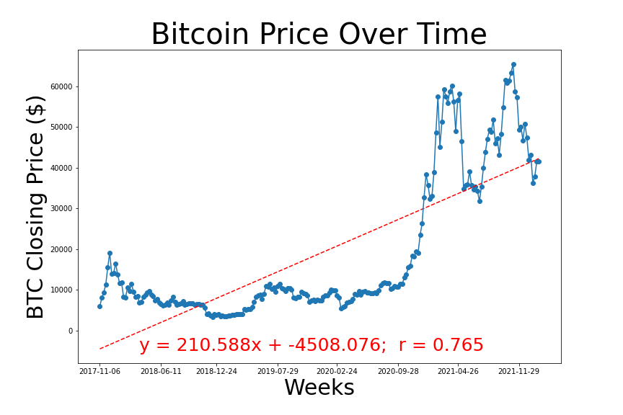
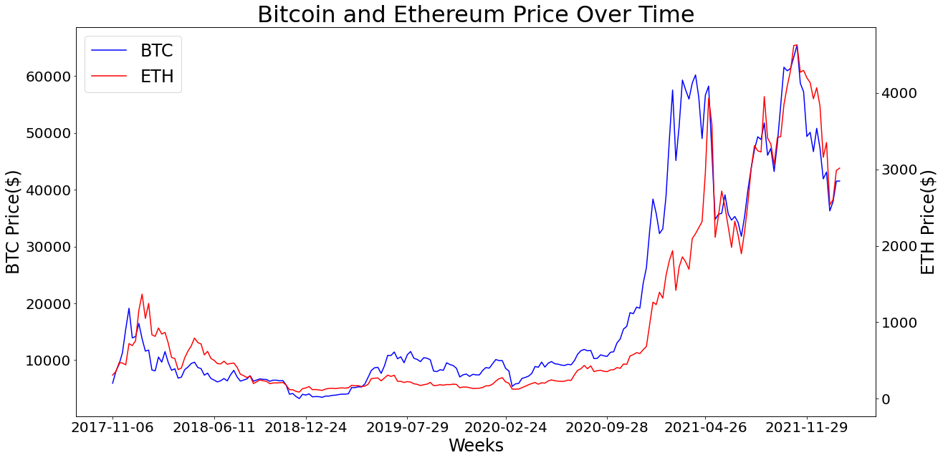
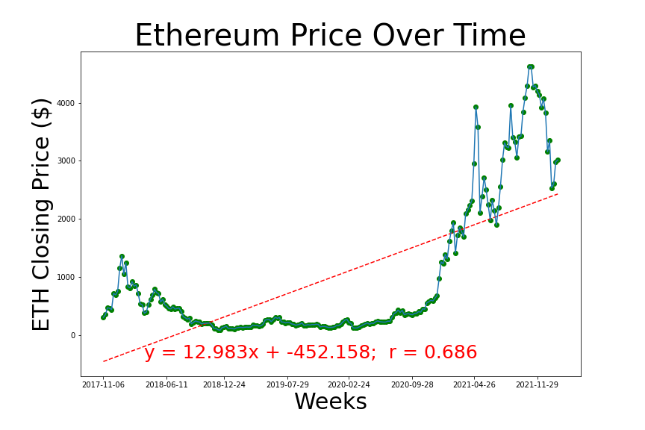
Scatter plots and regression analysis
Notes:
Regression analysis was used as a statistical methodology to help estimate the strength and direction of the relationship between two or more variables, using the BTC and ETH currency against price over time.

Slide 7
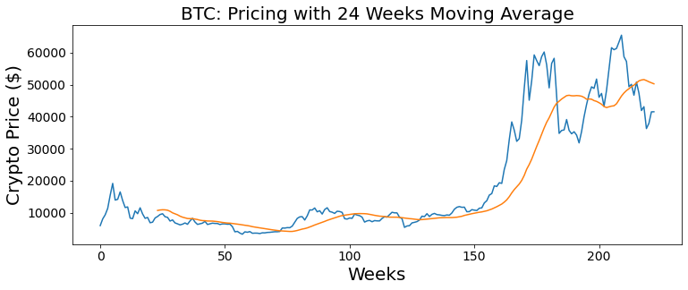
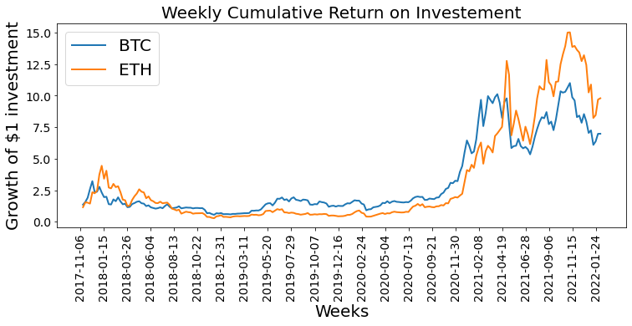
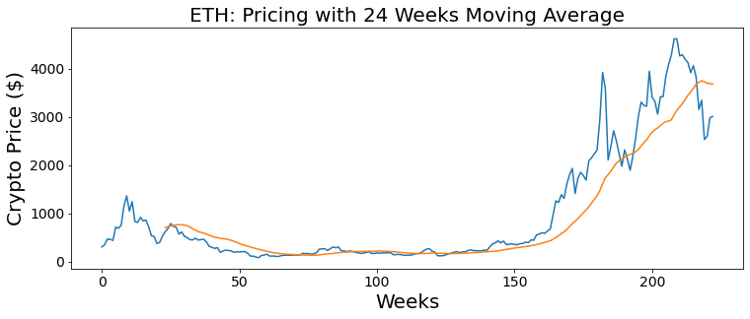
Weekly changes and 6 months moving average
Notes:
This viewgraph shows couple of metrics to visualize the long-term trends of the crypto currencies studied.
The first one : cumulative return on an investment is the aggregate amount that the investment has gained or lost over time, independent of the amount of time involved. The cumulative return is expressed as a percentage as seen on y axis. As can be seen the Ethereum cumulative return on investment is relatively much encouraging than bitcoin.
The second metric Moving averages help clarify a trend starting and finishing. The direction of the stock's moving average is important as it signals the trend. When a moving average starts to point down, the price has moved below the moving average. A 6 months moving average is considered here as a long-term indicator.
As can be seen from the view graph
BTC 6 months moving averages shows couple of downs indicating more volatility compared to ETH currency.

Slide 8
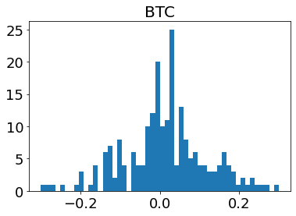
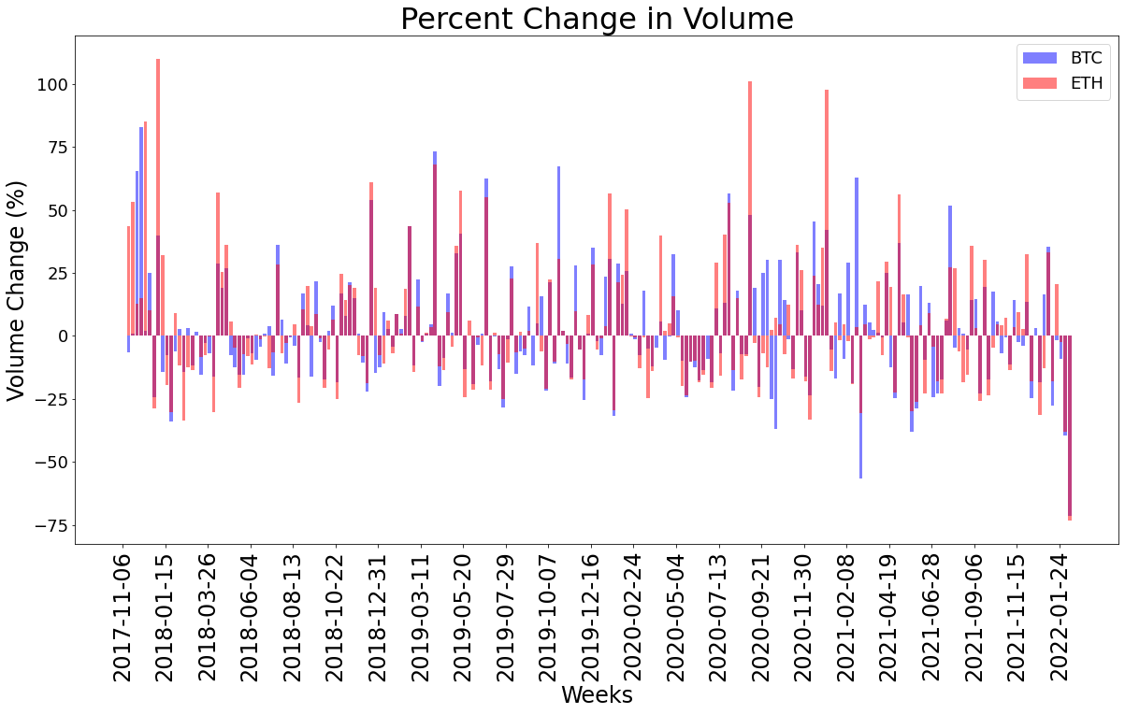
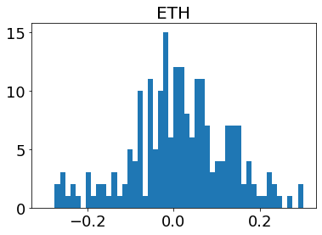
Weekly Trade Volume Changes and Return on Investment
Notes:
However weekly and cumulative returns are high for ETH over the the time period studied (8/17 - 7/21).
Return on investment histograms confirm the same.

Slide 9
Conclusion
Despite some fluctuations over time, Bitcoin and Ethereum crypto currency are solid investments opportunities
Bitcoin (r=0.77) and Ethereum (r=0.69) have a positive correlation over time
However, it is important to understand external factors such as policy changes before investing
Fluctuation changes are connected to market changes
Ethereum have similar fluctuations as Bitcoin, yet it is more affordable
Both cryptocurrency has shown multiple long term periods of sustainability
Notes:
As we have seen through the graphs both ethereum and bitcoin have had similar trends due to their current market trends and external processes. Looking through the current graph there have been multiple period of long term sustainability and there are some conclusions in that this is still a work in progress.

Slide 10
References
Haddad, S. (2021, July). Bitcoin Data: Bitcoin Historical Data. https://www.kaggle.com/skanderhaddad/bitcoin-data?select=btc_day.csv
Orac, R. (2019, August). Cryptocurrency Analysis with Python-Buy and Hold.
https://towardsdatascience.com/cryptocurrency-analysis-with-python-buy-and-hold-c3b0bc164ffa
Verma, A. (2021, December). Ethereum Data: Ethereum USD(ETH-USD) Daily data 2015-2021. https://www.kaggle.com/varpit94/ethereum-data?select=ETH-USD.csv

